Slide 1

Application Layer
Module-VII
Domain Name System (DNS)
Dr. S.L.JAYALAKSHMI, VIT Chennai

Slide 2
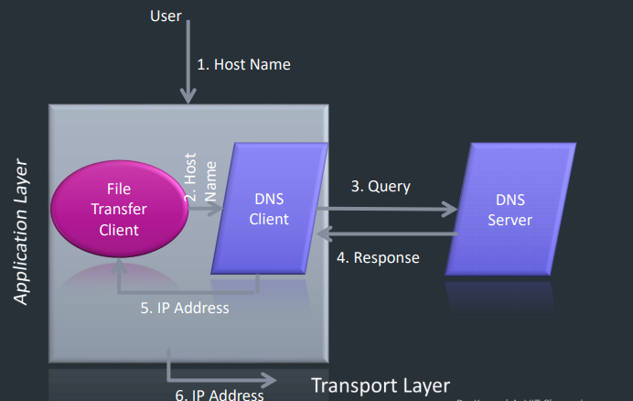
Purpose of DNS

Slide 3
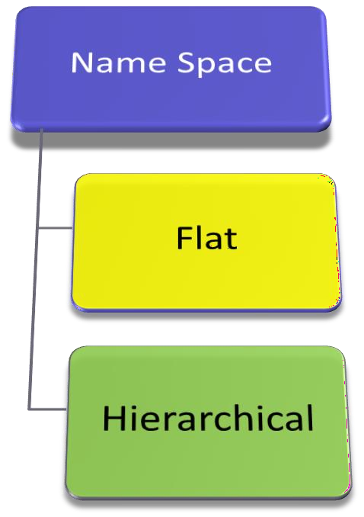
Name Space
Mapping address to a unique name

Slide 4
Flat Name Space
Name – Unstructured sequence of characters
May or may not have a common section
Disadvantage
It cannot be used in a large system
It must be centrally controlled to avoid ambiguity and
duplication.

Slide 5
Hierarchical Name Space
Each name is made of several parts
First part - nature of the organization
Second part - name of an organization
Third part - departments in the organization
Domain Name Space

Slide 6
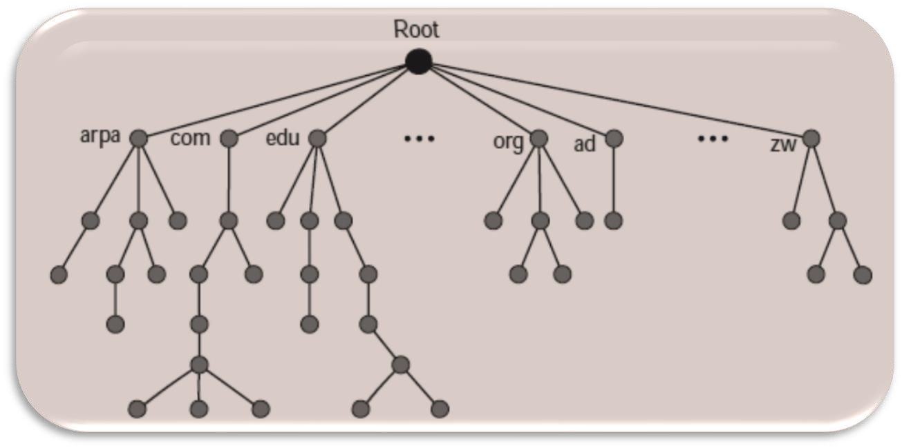
Domain Name Space
Inverted-tree structure
128 levels: level 0 (root) to level 127

Slide 7
Label and Domain Name
Node Label - string with a maximum of 63 characters
Root label - null string (empty string)
Child node have different labels
Guarantees the uniqueness of the domain names
Each node has a domain name
The domain names are read from the node up to the root
The last label is the root label (null)
Fully Qualified Domain Name (FQDN)ends in a null label

Slide 8
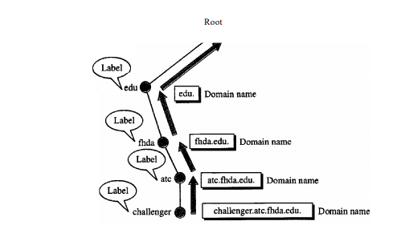

Slide 9
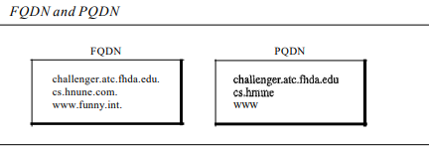

Slide 10

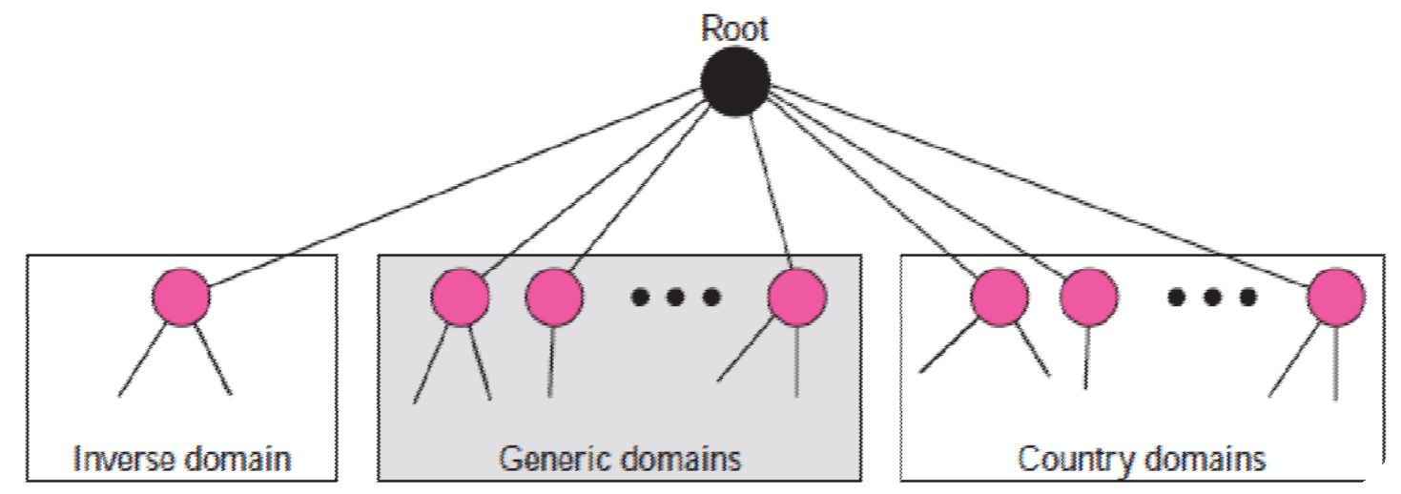

DNS in the Internet

Slide 11
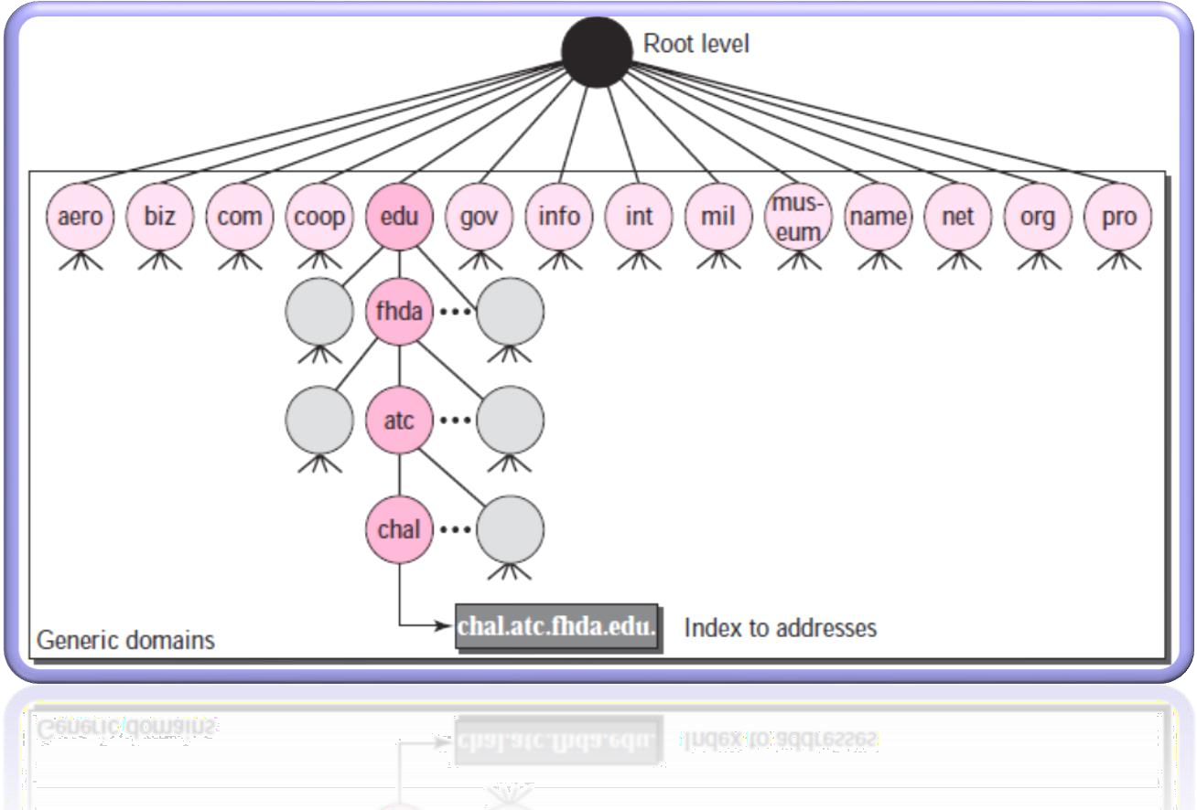
Generic Domain

Slide 12
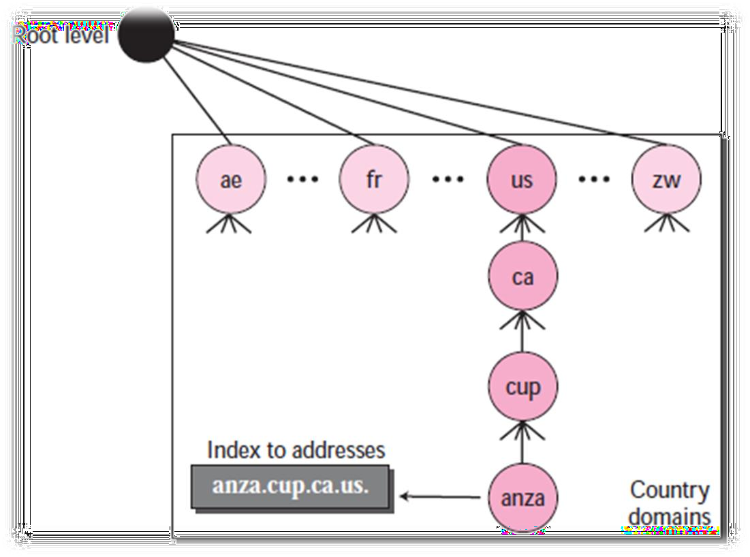

Country Domain

Slide 13
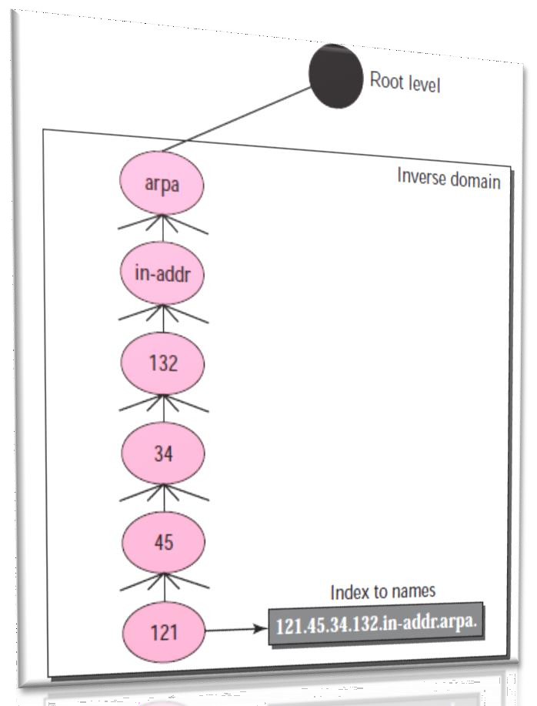
Inverse Domain

Slide 14
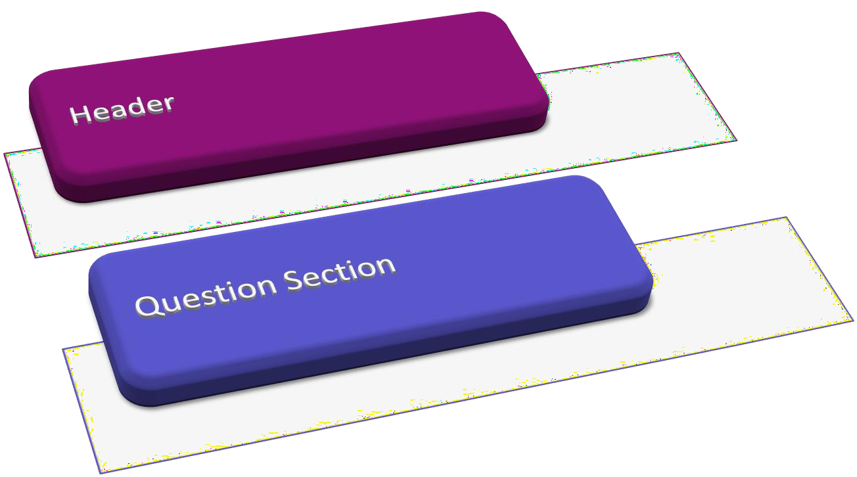
DNS Message Format

Slide 15
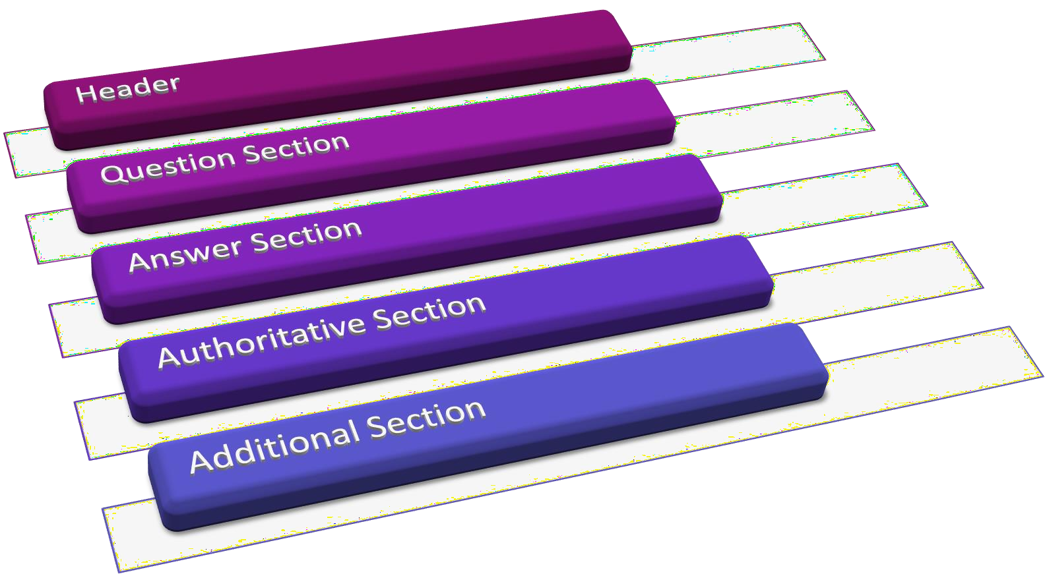
DNS Message Format

Slide 16
DNS Resolution
Resolver
Client-server application
Resolver - A host that needs to map an address to a name or a name to an address calls a DNS client
It accesses the closest DNS server with a mapping request.
If the server has the information, it satisfies the resolver
Otherwise, it either refers the resolver to other servers or asks
other servers to provide the information.
It interprets the response to see if it is a real resolution or an error
Finally delivers the result to the process that requested it

Slide 17
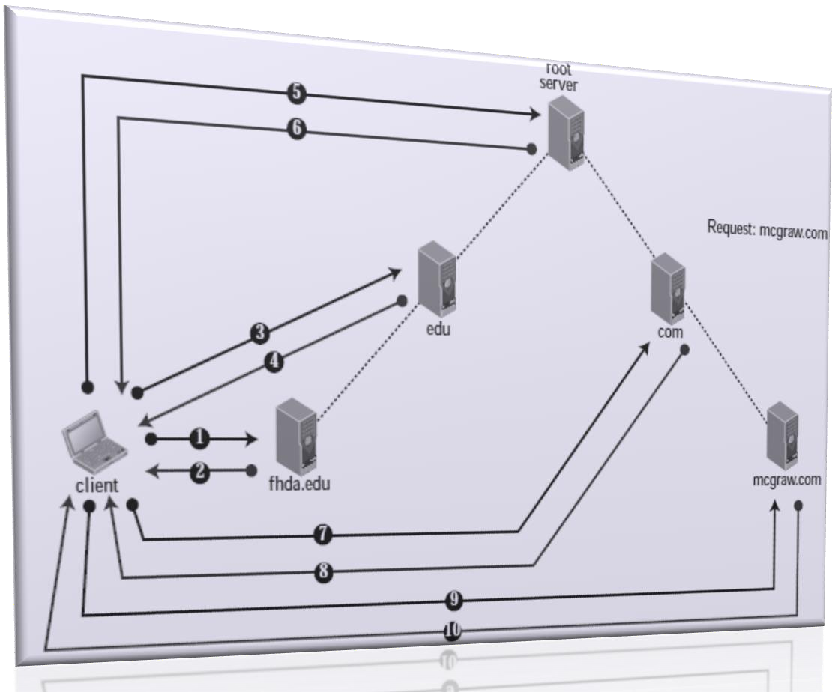
Iterative Resolver

Slide 18
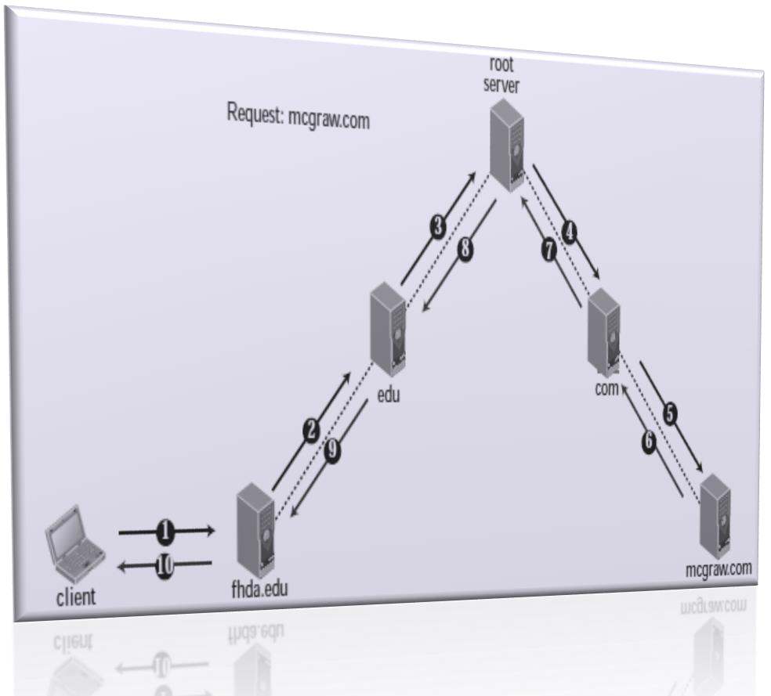
Recursive Resolver

Slide 19

File Transfer Protocol (FTP)
FTP
user interface
FTP
client
file transfer
FTP
server
user
at host
remote file system
local file system
transfer file to/from remote host
client/server model
client: side that initiates transfer (either to/from remote)
server: remote host

Slide 20
File Transfer Protocol (FTP)
FTP client contacts FTP server at port 21
client authorized over control connection
client browses remote directory by sending commands over control connection.
when server receives file transfer command, server opens 2nd TCP connection (for file) to client
after transferring one file, server closes data connection.
server opens another TCP data connection to transfer another file.
FTP server maintains “state”: current directory, earlier authentication

Slide 21

File Transfer Protocol (FTP)
TCP control connection port 21
TCP data connection port 20
FTP
client
FTP
server

Slide 22
File Transfer Protocol (FTP)
Multiple connections are used
for each directory listing and file transmission
No integrity check at receiver
Messages are sent in clear text
including Passwords and file contents
can be sniffed by eavesdroppers
Solution
Secure FTP (SSH FTP)
allows a range of operations on remote files
FTPS ( FTP over Secure Sockets Layer (SSL) )
Transport Layer Security (TLS) encryption

Slide 23
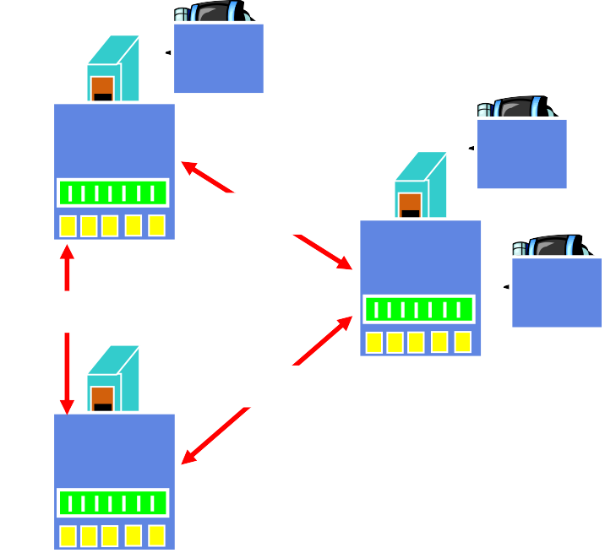


Electronic Mail
outgoing
message queue
user mailbox
user
agent
mail server
user agent
SMTP
mail server
user agent
SMTP
SMTP
mail server
user agent
user agent
user agent

Slide 24
Electronic Mail
Three major components:
user agents
mail servers
simple mail transfer protocol: SMTP
User Agent
“Mail reader”
composing, editing, reading mail messages
e.g., Eudora, Outlook, elm, Mozilla Thunderbird
outgoing, incoming messages stored on server

Slide 25
Electronic Mail
Mail Servers
mailbox contains incoming messages for user
message queue of outgoing (to be sent) mail messages
SMTP protocol between mail servers to send email
messages
client: sending mail server
“server”: receiving mail server

Slide 26
Electronic Mail
Mail Servers
mailbox contains incoming messages for user
message queue of outgoing (to be sent) mail messages
SMTP protocol between mail servers to send email
messages
client: sending mail server
“server”: receiving mail server

Slide 27
Electronic Mail: SMTP [RFC 2821]
uses TCP to reliably transfer email message from client to server (port 25)
direct transfer: sending server to receiving server
three phases of transfer
handshaking (greeting)
transfer of messages
closure
command/response interaction
commands: ASCII text
response: status code and phrase
messages must be in 7-bit ASCII

Slide 28
Simple Mail Transfer Protocol(SMTP)
SMTP uses persistent connections
SMTP requires message (header & body) to be in 7-bit ASCII
SMTP server uses Carriage Return/Line Feed (CRLF).CRLF to determine end of message in any OS

Slide 29
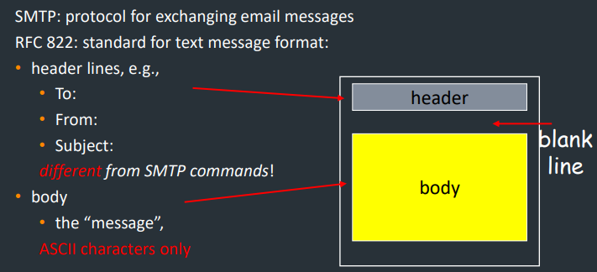
Mail Message Format

Slide 30
Message format: Multimedia Extensions
MIME: multimedia mail extension, RFC 2045, 2056
additional lines in msg header declare MIME content type
From: alice@crepes.fr
To: bob@hamburger.edu Subject: Picture of yummy crepe.
MIME-Version: 1.0
Content-Transfer-Encoding:
base64
MIME version
method used to encode data
multimedia data type, subtype,
parameter declaration
encoded data
Content-Type: image/jpeg
base64 encoded data .....
.........................
......base64

Slide 31
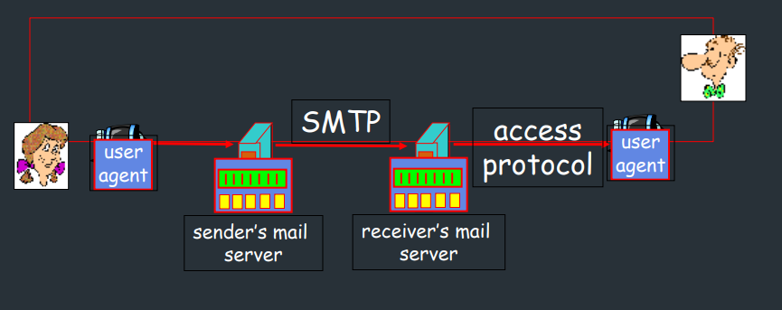

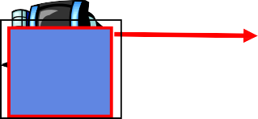
Mail Access Protocols
SMTP
access
user
user
protocol
agent
agent
sender’s mail server
receiver’s mail server

Slide 32
Mail Access Protocols
SMTP: delivery/storage to receiver’s server
Mail access protocol: retrieval from server
POP: Post Office Protocol [RFC 1939]
authorization (agent <-->server) and download
IMAP: Internet Mail Access Protocol [RFC 1730]
more features (more complex)
manipulation of stored msgs on server
HTTP: gmail, Hotmail, Yahoo! Mail, etc.

Slide 33




Hyper Text Transfer Protocol
PC running
Explorer
Server running Apache Web server
Mac running
Navigator

Slide 34
Hyper Text Transfer Protocol
Web page consists of base HTML-file which includes several referenced objects
Each object is addressable by a Uniform Resource Locator (URL)
URL contains 4 things : method, host computer, port and path,
HTTP is used as the webpage application layer protocol
client/server model
client: browser that requests, receives, “displays” Web objects
server: Web server sends objects in response to requests
uses TCP – Port 80
assures inter-operatability

Slide 35
HTTP Connections
Non-Persistent HTTP
At most one object is sent over a TCP connection.
Persistent HTTP
Multiple objects can be sent over single TCP connection between client and server.

Slide 36


Non-Persistent HTTP: Response time
initiate TCP connection
RTT
request file
time to transmit file
RTT
file received
time
time

Slide 37
Non-Persistent HTTP: Response time
Definition of Round Trip Time: Time for a small packet to travel from client to server and back.
Response time:
one RTT to initiate TCP connection
one RTT for HTTP request and first few bytes of HTTP response
to return
file transmission time
total = 2RTT+transmit time

Slide 38
Persistent HTTP
Non-persistent HTTP issues:
requires 2 RTTs per object
OS overhead for each TCP connection
browsers often open parallel TCP connections to fetch
referenced objects
Persistent HTTP
server leaves connection open after sending response
subsequent HTTP messages between same client/server sent over open connection
client sends requests as soon as it encounters a referenced object
as little as one RTT for all the referenced objects

Slide 39
NETWORK MANAGEMENT SYSTEM
We can say that the functions performed by a network management system can be divided into five broad categories: configuration management, fault management, performance management, security management, and accounting management.

Slide 40
SIMPLE NETWORK MANAGEMENT PROTOCOL (SNMP)
The Simple Network Management Protocol (SNMP) is a framework for managing devices in an internet using the TCP/IP protocol suite. It provides a set of fundamental operations for monitoring and maintaining an internet.

Slide 41
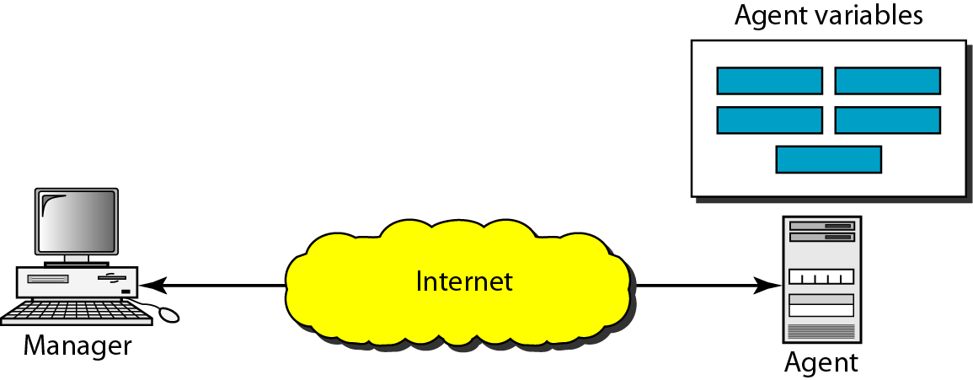
SNMP concept

Slide 42
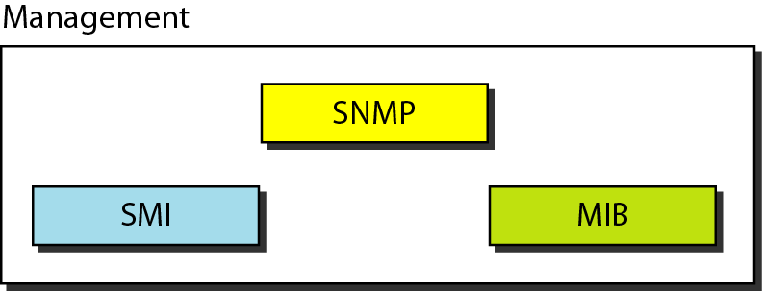
Components of network management on the Internet
Structure of management
Information
Management Information Base

Slide 43
SNMP defines the format of packets exchanged between a manager and
an agent. It reads and changes the status (values) of objects (variables)
in SNMP packets.

Slide 44

Note
SMI defines the general rules for naming objects, defining object types (including
range and length), and showing how to encode objects and values. SMI does not define the number of objects an entity should manage or name the objects to be managed or define the association between the objects and their values.

Slide 45
MIB creates a collection of named objects, their types, and their relationships to each other
in an entity to be managed.

Slide 46
We can compare the task of network management to the task of writing a program. ❏ Both tasks need rules. In network management this is handled by SMI.
❏ Both tasks need variable declarations. In network management this is handled by MIB.
❏ Both tasks have actions performed by statements. In network management this is handled by SNMP.

Slide 47
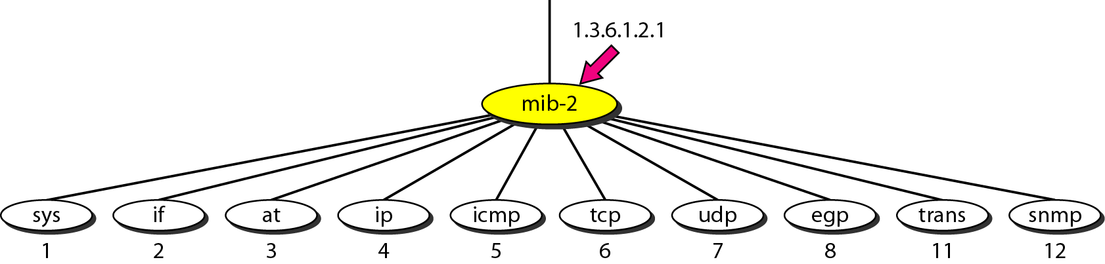
MIB-2

Slide 48
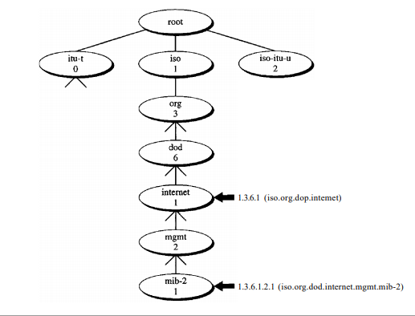
MIB tree structure

Slide 49
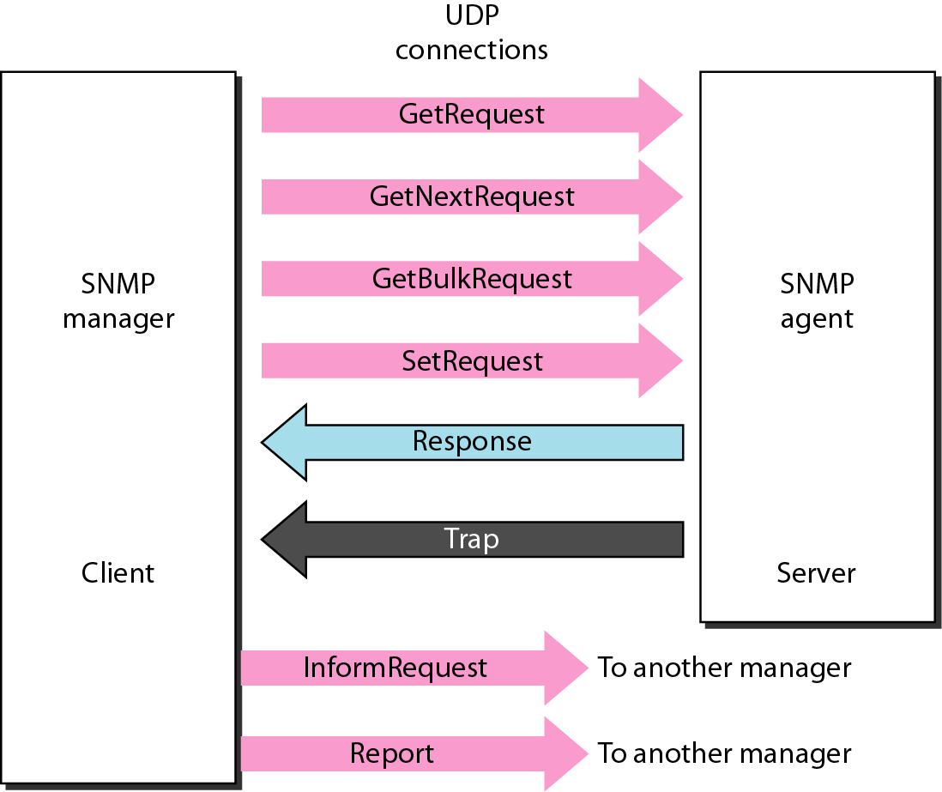
SNMP PDUs

Slide 50
Other Protocols
RARP (Reverse ARP): RARP (defined in RFC903) is an early protocol for dynamic IP address assignment in Ethernet networks. RARP is severely limited in that it does not support assigning name servers and default gateway. For these reasons RARP has been supplanted by BOOTP and the more modern DHCP. [Finds the IP address for the given physical address]
BOOTP (Bootstrap Protocol): BOOTP (defined in RFC951) has been introduced for assigning IP addresses and other information such as name server and default gateway. Additionally BOOTP may be routed between sub-nets since it is based on UDP/IP.
DHCP (Dynamic Host Configuration Protocol): DHCP (defined in RFC2131) eliminates some of the limitations present in BOOTP such as restricted vendor option size and lack of a lease time for IP addresses.
TFTP: It can read or write a file for the client.

